Slide 1


Visvesvaraya Technological University, Belagavi, Karnataka Jawaharlal Nehru New College of Engineering, Shivamogga - 577204 Department of Computer Science & Engineering A DBMS MINI- PROJECT ON “RESTAURANT DATABASE MANAGEMENT SYSTEM”
Submitted by
Name USN
Bhavana R M 4JN20CS022
Dhathri Krishna V 4JN20CS028
Nisarga S 4JN20CS066
Pooja B 4JN20CS069
Under the guidance of
Mrs. Sowmya D. _{M.Tech, (Ph.D)} Asst. Professor, Dept. of CS&E, JNNCE, Shivamogga | Mr. Mallesh Kumar K S _{B.E, M.Tech} Project Manager Centre for Innovation & Entrepreneurship JNNCE, Shivamogga

Slide 2
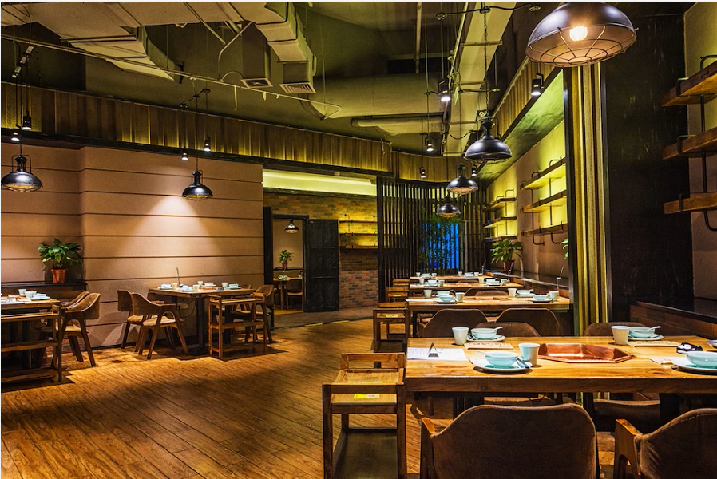
Content
Abstract
Introduction
ER & Schema Diagrams
Results & Snapshot
Conclusion
Future Scope
References

Slide 3
ABSTRACT
The project titled “RESTAURANT DATABASE MANAGEMENT SYSTEM” is designed with the motive of maintaining all the database of the concerned restaurant. The basic aim of the project is develop a system, which is very simple, user friendly ,easily retrieval and simple access. The project has been developed using NETBEANS IDE as front end and MYSQL as back end for the Restaurant Management.
This project is insight into the design and implementation of a Restaurant Database Management System. The primary aim of is to improve accuracy and enhance safety and efficiency in the restaurant. Today management is one of the most essential features of all form.
Management provides sophistication to perform any kind of task in a particular form. This is restaurant database management system; it is used to manage most restaurant related activities in the restaurant.

Slide 4
INTRODUCTION
Database management system or DBMS is a software designed to assist in managing and utilizing large collection in data, and the need of such system, as well as their use, is growing rapidly. The Alternative to using a DBMS is used to hoc approaches that do not carry over from one application to another.
Overview of DBMS
A database management system stores data in such a way that it becomes easier to retrieve, manipulate, and produce information. Database is a collection of related data and data is a collection of facts and figures that can be processed to produce information. The area of the Database Management system is microcosm of computer science in general. The issues addressed and the technique used to span a wide spectrum, including languages, object orientation and other programming paradigm ,compilation, operating system, concurrent programming ,data structures, algorithms, theory, parallel and distributed systems user interface, expert systems and artificial intelligence, statistical techniques, and dynamic programming.

Slide 5
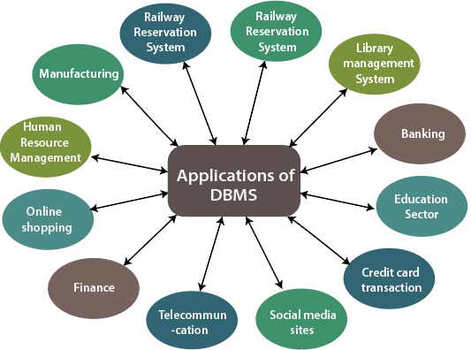
Applications of DBMS
Nowadays DBMS are used in almost all the areas ranges from
Science
Engineering
Medicine
Business
Industry
Government
Art
Entertainment
Education
Training.

Slide 6
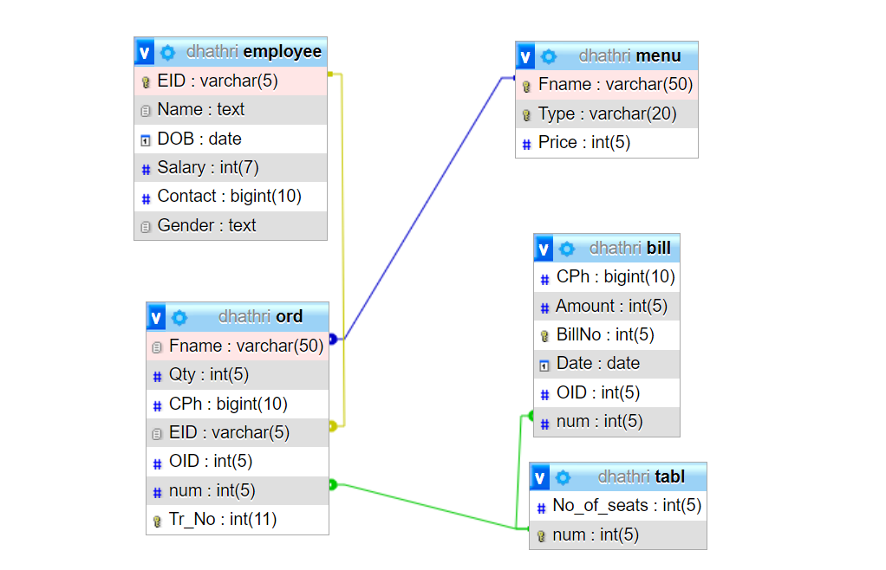
SCHEMA DIAGRAM

Slide 7
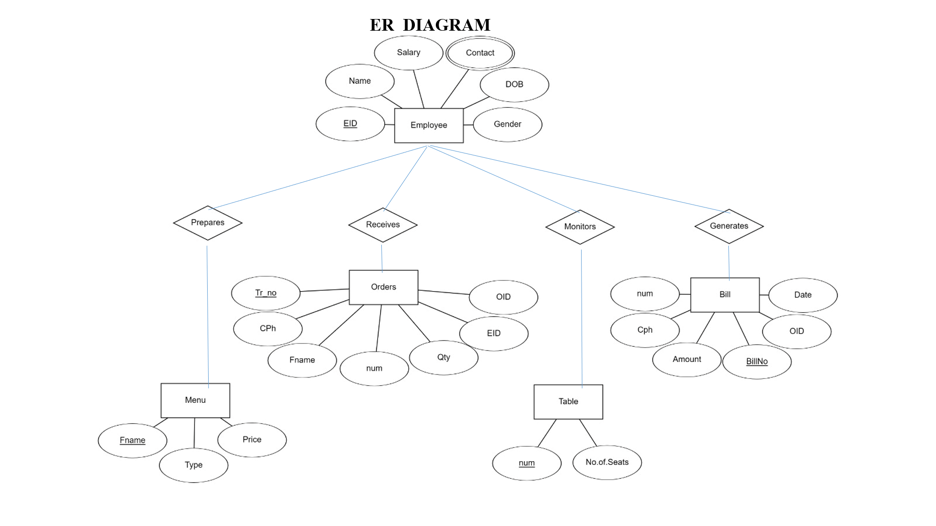

Slide 8
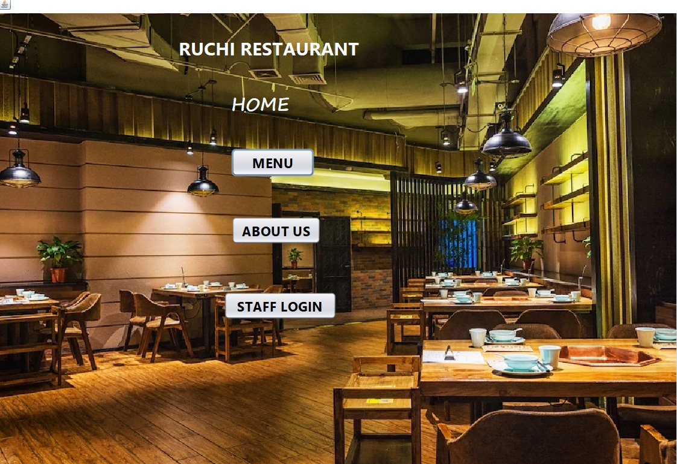
H
HOME PAGE

Slide 9
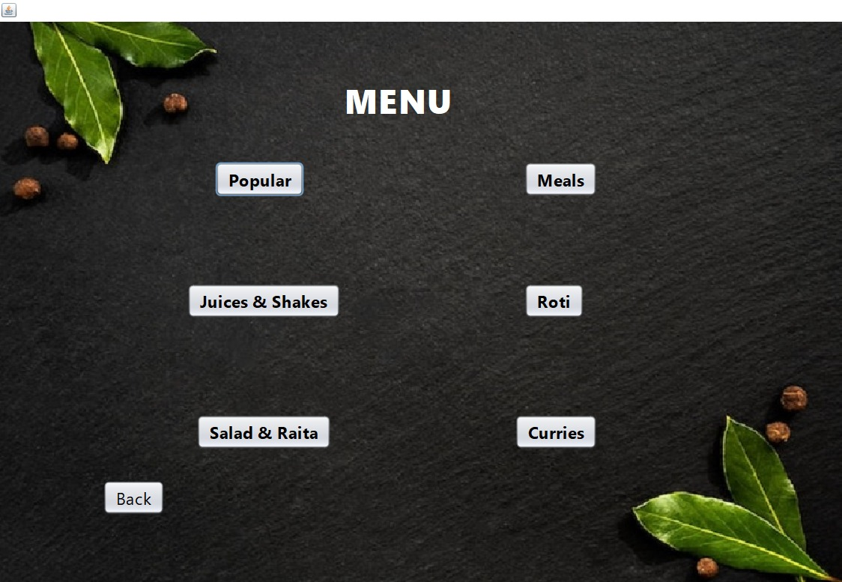
MENU PAGE

Slide 10
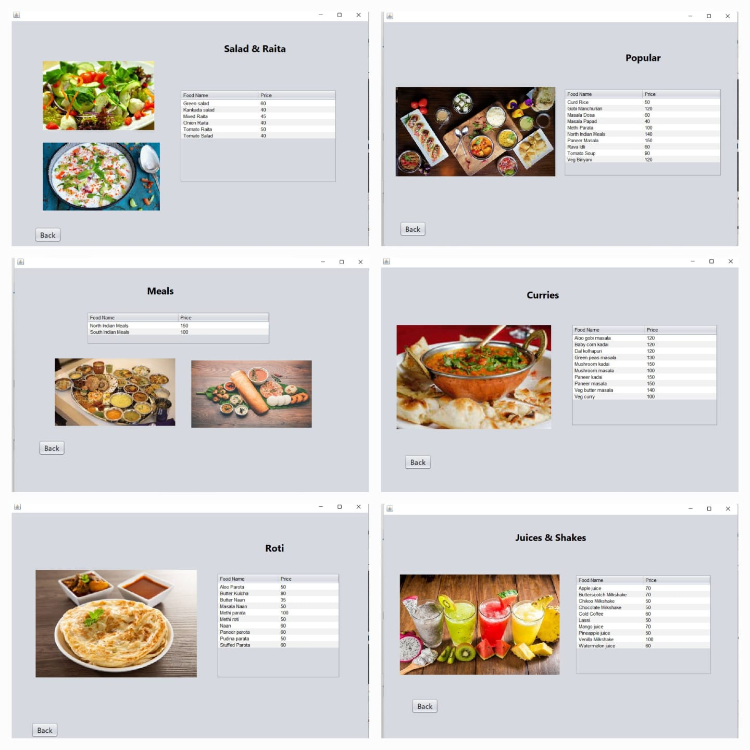

Slide 11
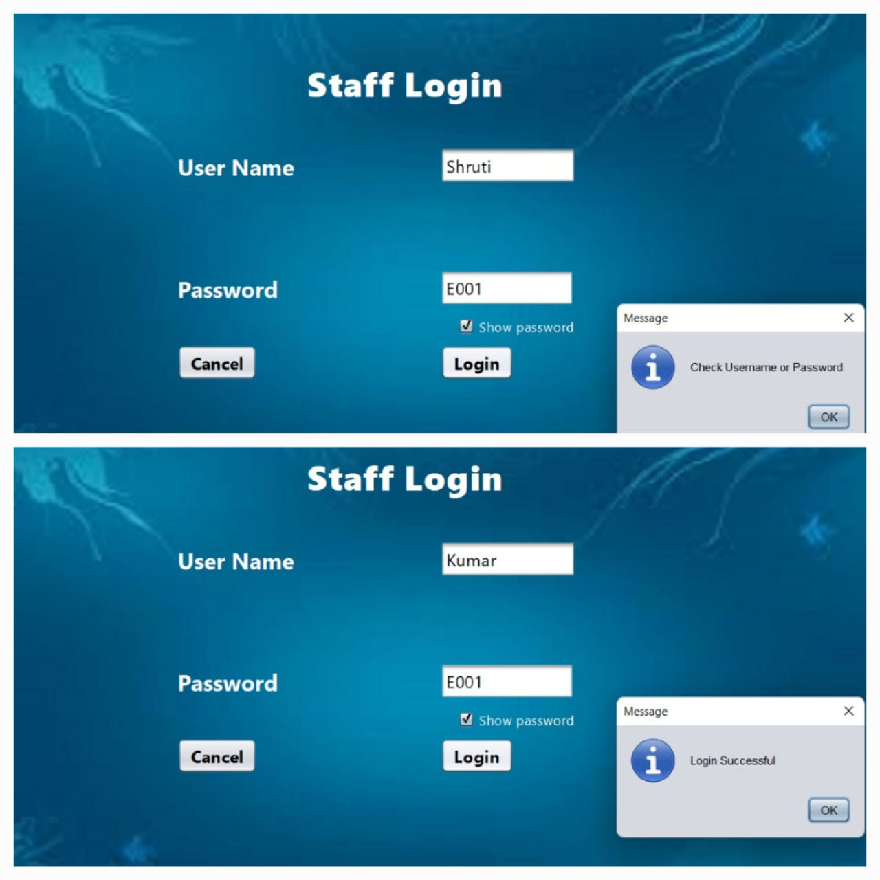
LOGIN PAGE
( Only Authenticated Users are allowed to Login)

Slide 12
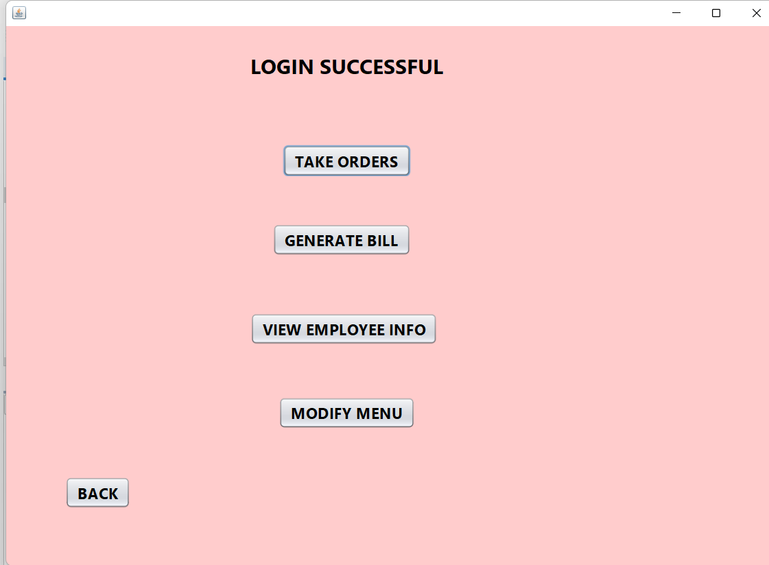
Options for Employee and Managers

Slide 13
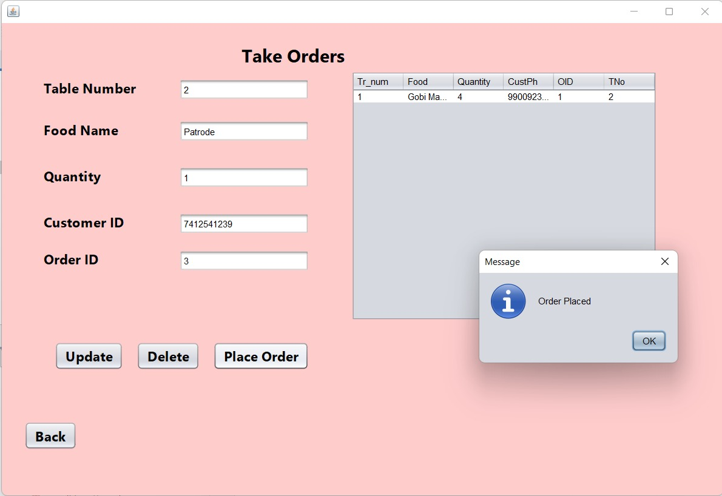
TAKING ORDERS

Slide 14
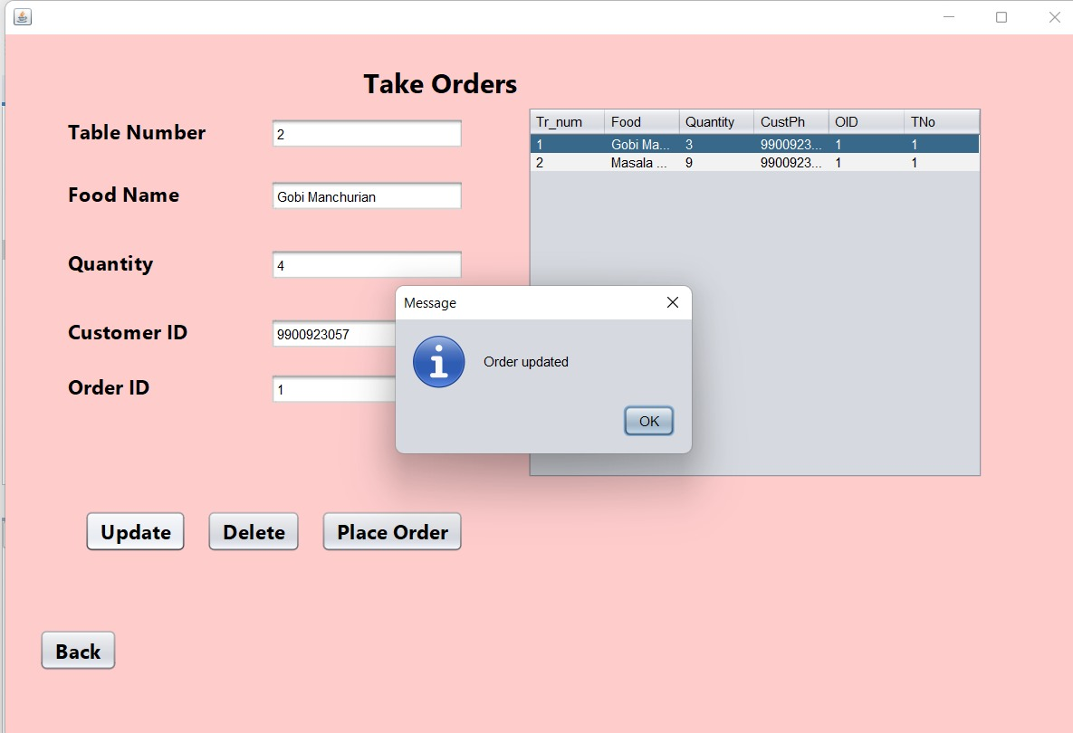
UPDATING ORDERS

Slide 15
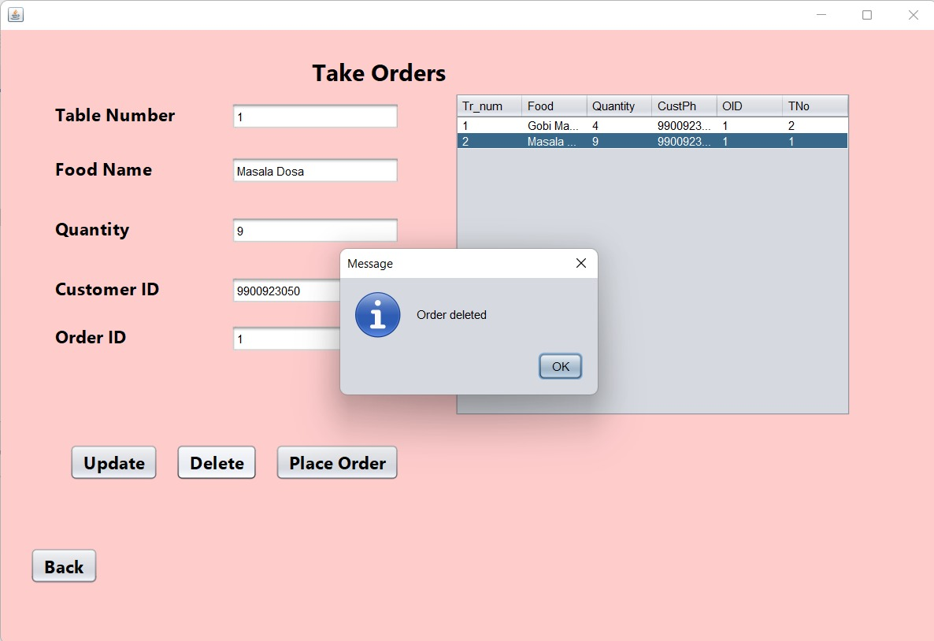
DELETING ORDERS

Slide 16
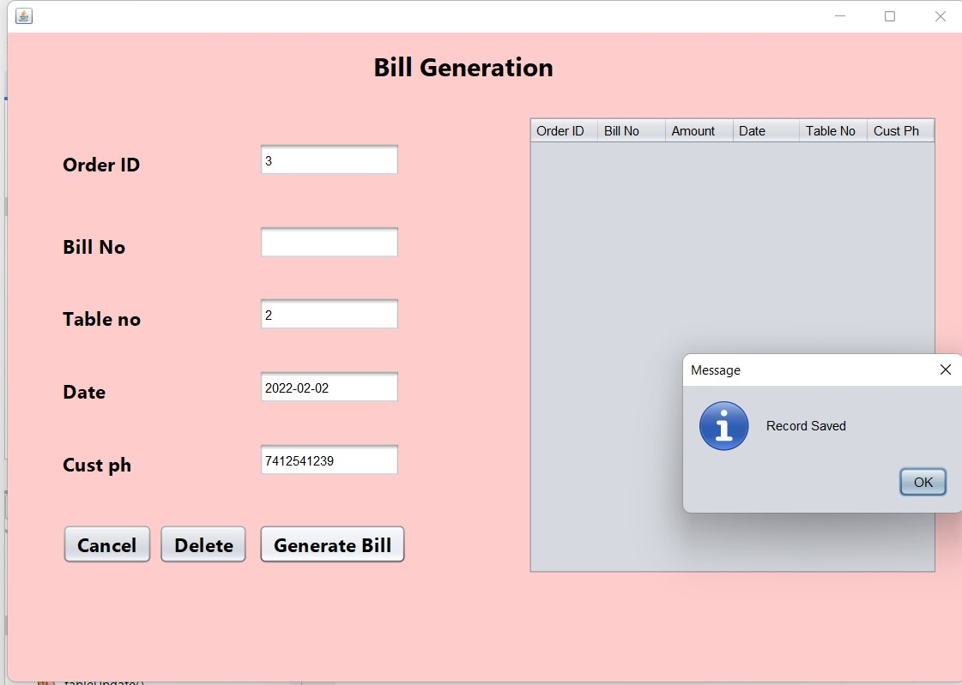
GENERATING BILL

Slide 17
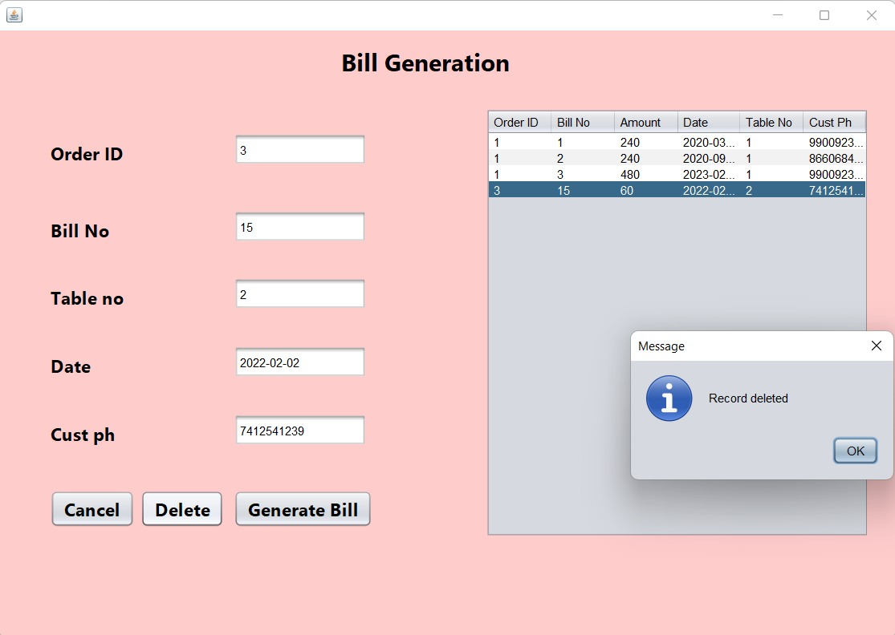
DELETING WRONG DATA BILLS

Slide 18
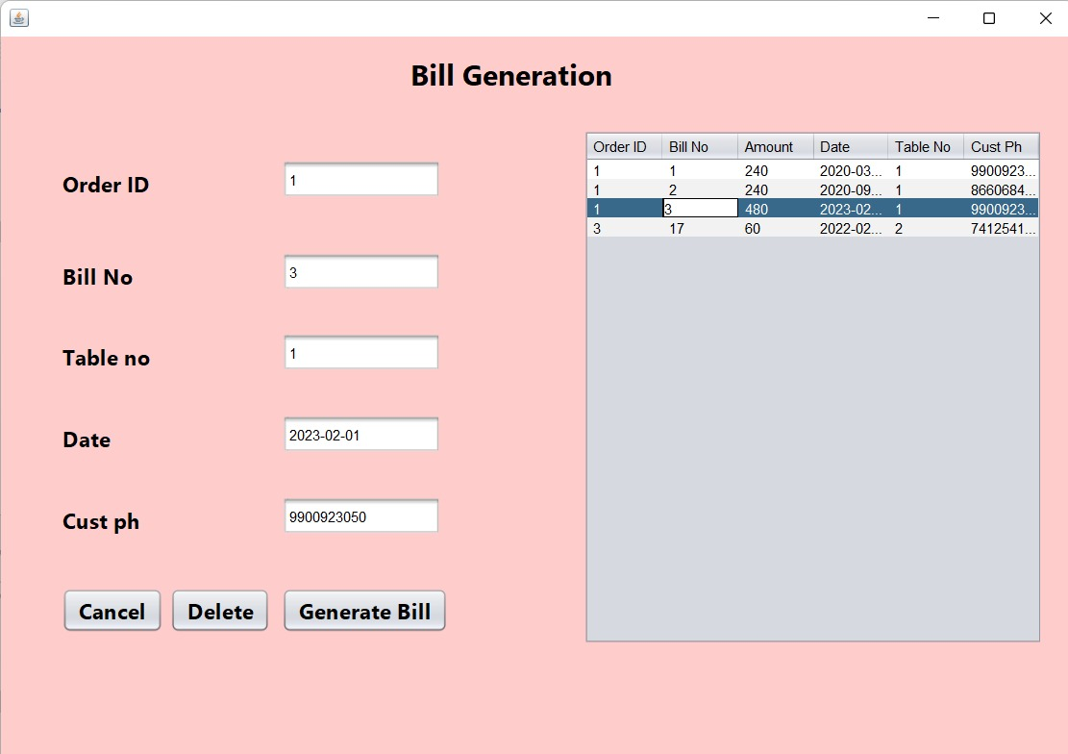
UPDATING BILL WITH EXTRA ORDERS

Slide 19
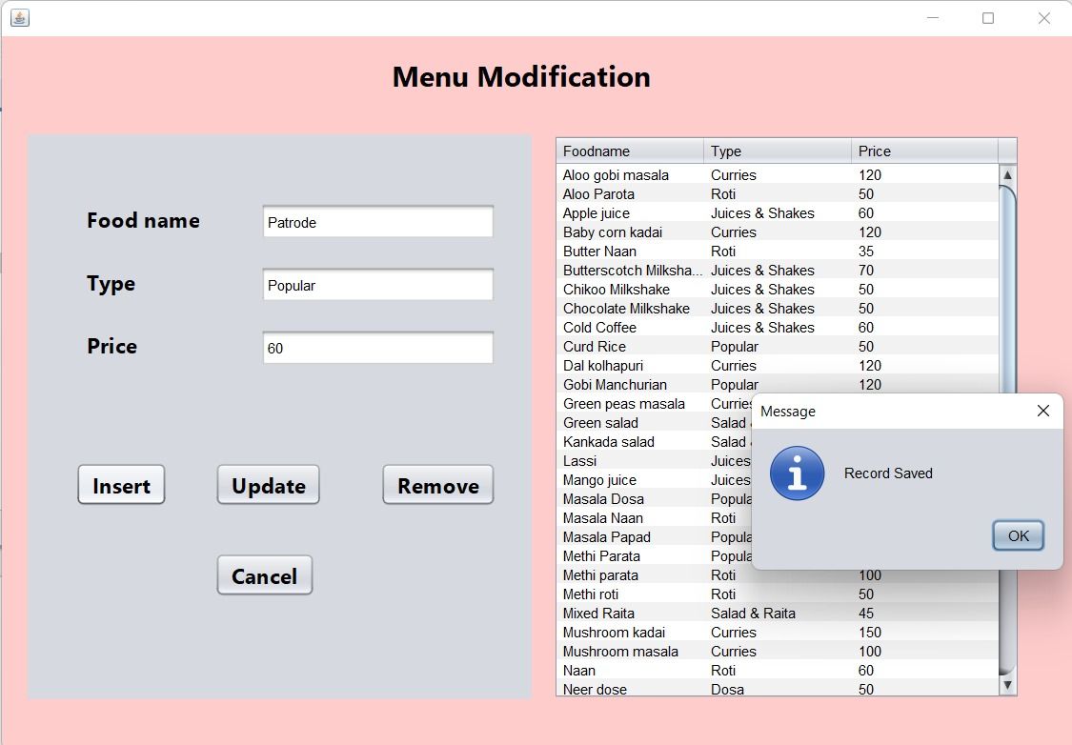
ADDING NEW FOOD ITEMS TO MENU

Slide 20
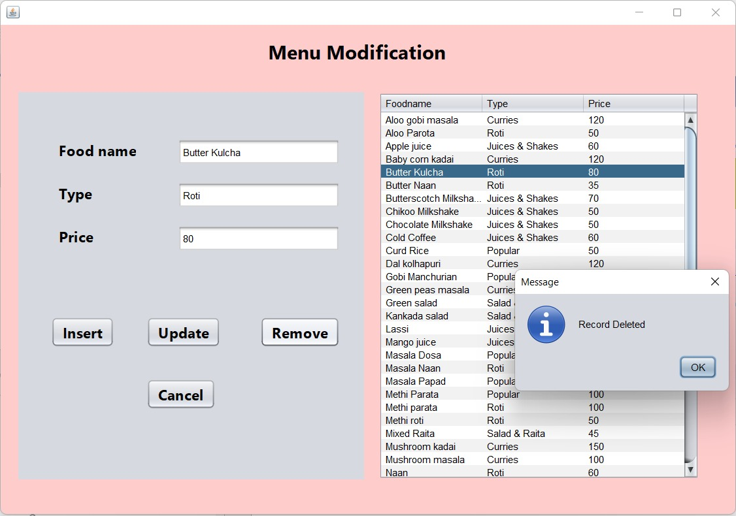
DELETING UNAVAILABLE FOOD ITEMS FROM MENU

Slide 21
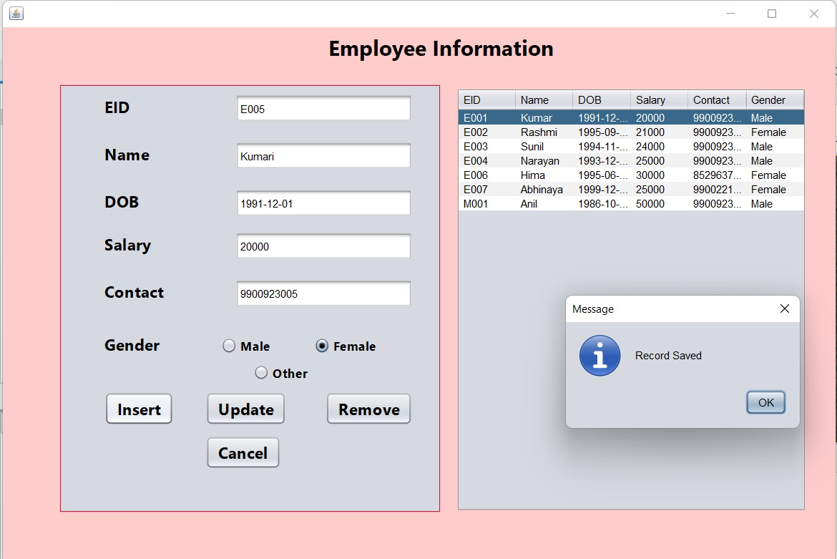
ADDING EMPLOYEE TO THE DATABASE
(Option available only for Managers)

Slide 22
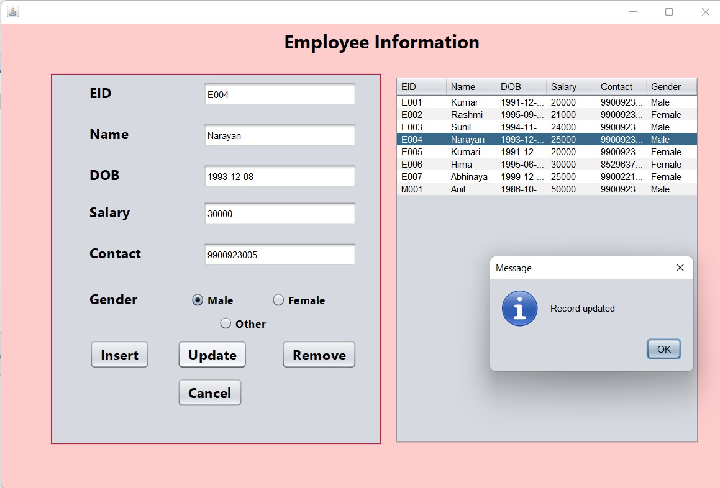
UPDATING EMPLOYEE DETAILS
(Option available only for Managers)

Slide 23
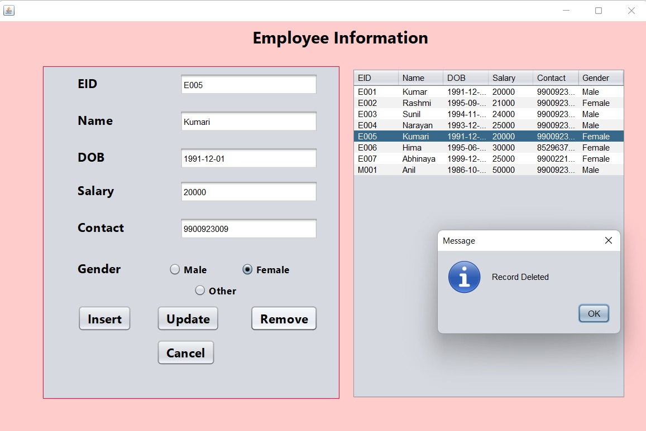
DELETING EMPLOYEE DETAILS
(Option available only for Managers)

Slide 24
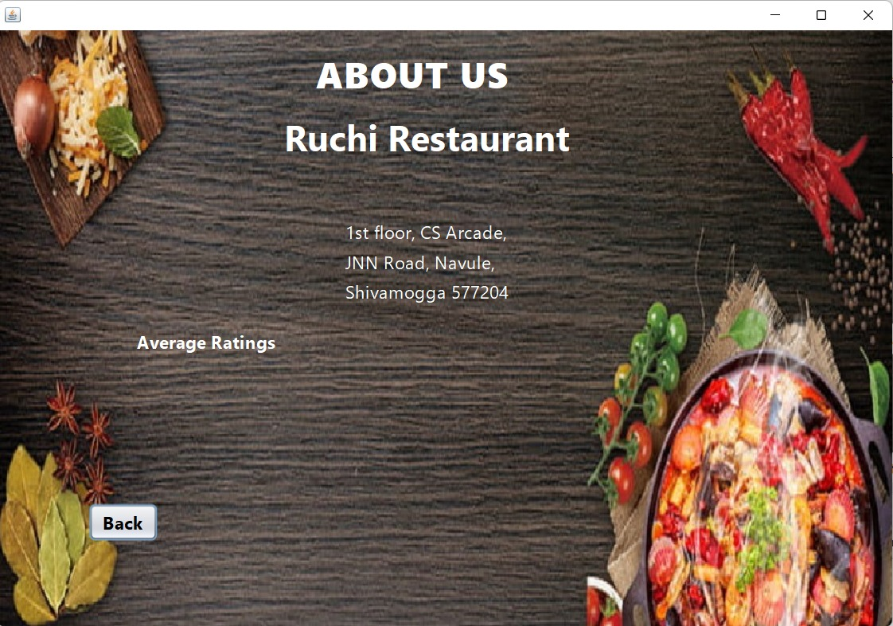
ABOUT THE RESTAURANT DETAILS

Slide 25
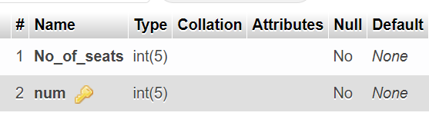
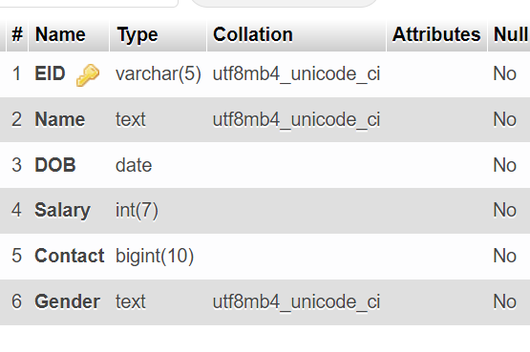
BACKEND
TABLE :
EMPLOYEE :

Slide 26
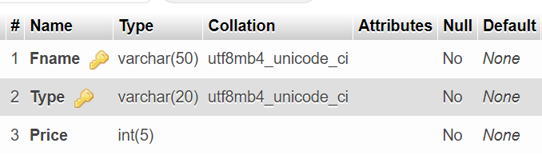
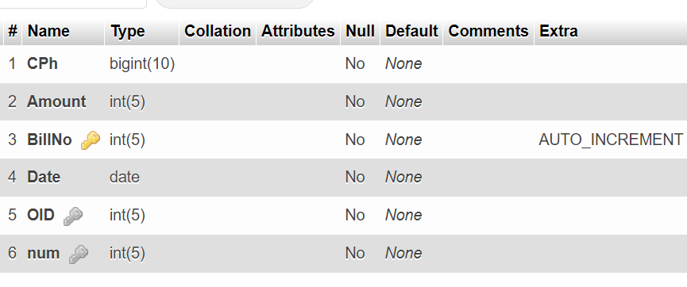
MENU :
BILL :

Slide 27
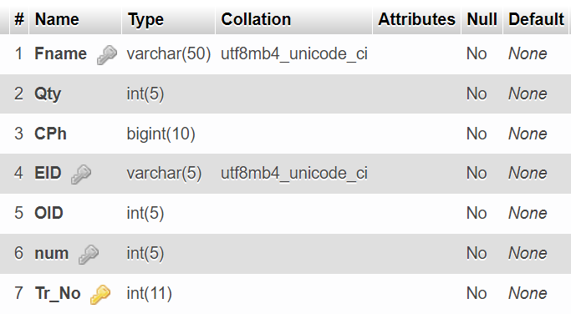
ORDER :

Slide 28
CONCLUSION
Today management is one of the most essential features of all form. Management provides sophistication to perform any kind of task in a particular form. This is RESTAURANT DATABASE MANAGEMENT SYSTEM; it is used to manage most restaurant related activities in the restaurant. The primary aim of is to improve accuracy and enhance safety and efficiency in the restaurant.
We may also conclude that by using restaurant software, processing both orders and refills can be done quickly and simply with just a few keystrokes or mouse clicks with new, easy to learn and use Graphical User Interface (GUI) restaurant management solution. That due to automation where the restaurant manager does his or her work much faster, a switch from product oriented to service oriented which is one of the most important keys in restaurant. In other words that the manager will have more time in counseling his/her customers, where the goal of servicing customers is one of the important solutions to avoid any error.
This project is to design an efficient maintain database system and it will make easy to access the records based on requirement. It will also improve decision making by reducing the processing time as well as reducing the communication gap between admin and customer. It will also reduce error in records.

Slide 29
Future Scope
The future scope of this project RESTAURANT MANAGEMENT SYSTEM is very wide. There are many additional features, which are planned to be incorporated during the future enhancements of this project. The Future version of System there is some point that we may implement on them:
developing an application for android devices that works on the same database which is the mini of MySQL.
REFERENCES
Ramez Elmasri and Shamkant B. Navathe, “Database systems Models, Languages, Design and Application Programming”, Pearson, 7th Edition, 2017,.
Raghu Ramakrishnan, and Gehrke, “Database management systems”, McGraw Hill, 3rd Edition, 2014.
Herbert Schildt: JAVA the Complete Reference, 7th/9th Edition, Tata McGraw Hill, 2007.
Jim Keogh: J2EE-TheCompleteReference, McGraw Hill, 2007.

Slide 30
THANK
YOU

